Slide 1
P10 Perimeter LED Display
Janet Gao
2019-07-08
ADD:No 9B, St 230, Sangkat Phsar Derm Kor I , Khan Tuol Kok, Phnom Penh, Cambodia.
Call :+855 23 63 99 719 / +855 63 99 738
Email: modernledcity@gmail.com
Skype: modernledcity@gmail.com

Slide 2
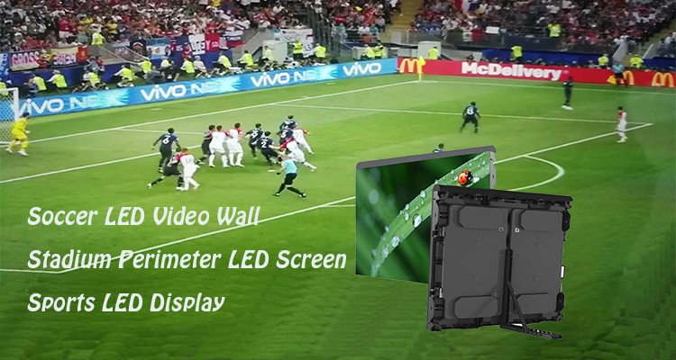
100m x1m P10 Outdoor LED Display on Stadium

Slide 3

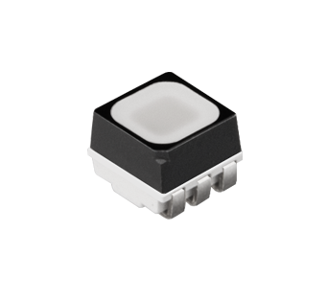
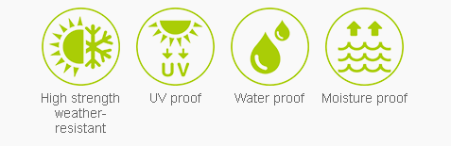
1,Feature of LED Lamp
LED Lamp
LED Type | SMD3535
LED chip and encapulated | Hongsheng, San'an led chip

Slide 4
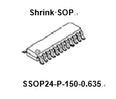

Driver ICs
IC name | ICN2028
Refresh Rate | 960-1920HZ
Lower Ghosting Effect Elimination | 16-channel constant current sink output LED driver
Advantages | Low-Gray Scale Enhancement Integrated Dual Latch for higher refresh rate
Major Application | Commercial LED Panel /Message Sign

Slide 5
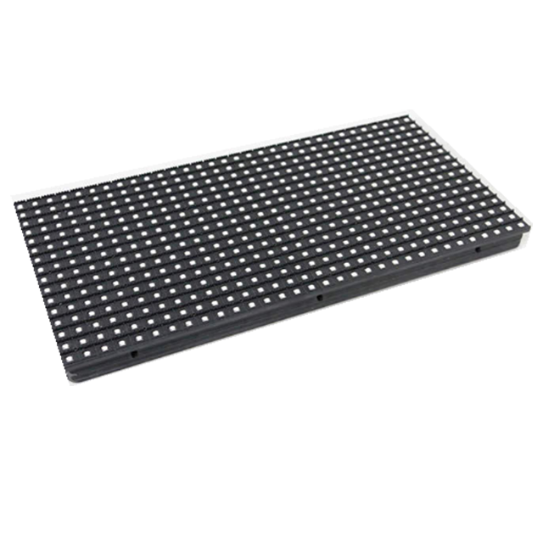
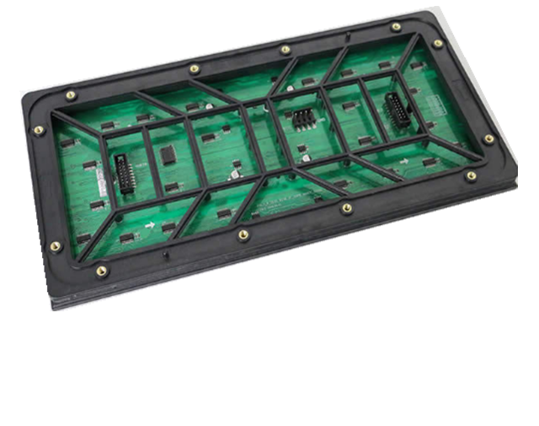
2,Feature of LED Module
LED Module
Pixel Pitch | 10 mm | Module Size | 320mm x 160mm
Pixel Configuration | 1R 1G 1B | Module Resolution | 32 x 16 pixels
Pixel Density | 10000 pixels/m² | Scan Method | 1/2 Scan
Pixel Life | >100,000 hrs | Module Max.Power | 40W

Slide 6
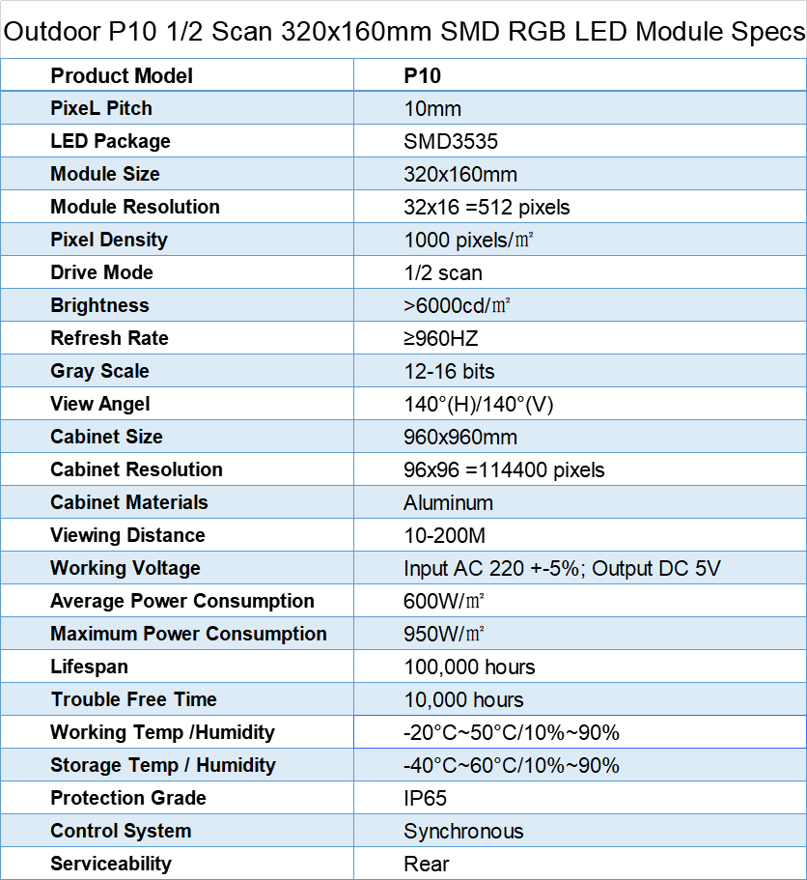
3,Specification Of Display LED Modules

Slide 7
1. LED Lamp must be able to work well in the temperature range
'-20°C~50°C
2.The lifespan of LED Lamp (LED lamp) not less than 100,000 hours at 25 degree C. (YES) or (No) YES
3. LED Lamp View Angle Vertical & Horizontal : 90°~ 140°
4. LED Module is designed to have a number of image points (Pixels) that mix at least 281 trillion colors, with 1 point illustrated with 1 red LED Lamp, 1 green and 1 blue with a number of image points.
Module pixel is 32 x 16 dots, images and the distance between the image points (Pixels Pitch) is equal to 10 mm
5. LED Module Front, water and moisture resistant coating with silicone (silicones), black, flexible, chemical resistant and non-flammable. (YES) or (No) YES

Slide 8
6.LED Module (LED) The back of the moisture-resistant coating that may corrode the copper of the PCB Board with Silicone Conformal Coating (YES) or (No) Module back have moisture-resistant coating,but without silicone coating which is not good for module heating emission.
7.LED Module has a structure made of PC material, polycarbonate, resistant to high temperature conditions, outdoor well. By showing the test results from the trustworthy organization on the date of submission (YES) or (No)
YES

Slide 9
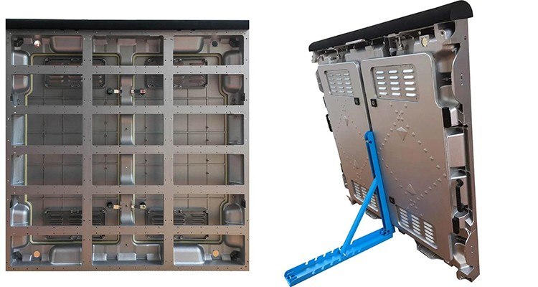
4,Feature Of Cabinets
LED Display Cabinet
Cabinet Size | 960x960mm | Cabinet Type | Waterproof Outdoor Cabinet
Cabinet Resolution | 96x96 pixels | Cabinet Materials | Aluminum
Installation way | Rental | IP Rate | Front/ Rear IP65

Slide 10
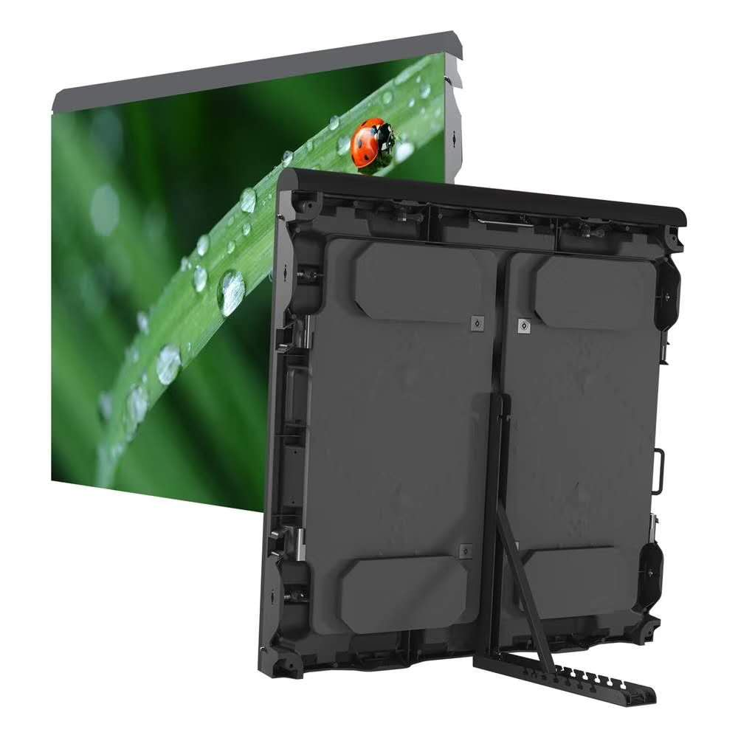
Cabinet Features:
Dimension:960mm*960mm
Thickness:150mm
Material:Aluminum
Feature:can be used in indoor and outdoor,dual-door,soft protective cover on the top to cushion the impact force,adjustable kickatand to reach the perfect viewing angle.

Slide 11
LED Screen
Optimal viewing distance | ≥10m
White Balance Brightness Value | ≥6000cd/ m²
Power Supply | G-energy 5V60A
Operating Voltage | AC 220V ± 10%，50HZ± 5%
IP rate | Front/ Rear IP65
Avg & Max. power consumption | 600W/ m² & 950W / m²
Gray Scale | R/G/ B:4096 grades each color & R/G/B: 12-14 bits
Earth leakage | ＜3.5mA/㎡（Exchange rms value）
Assembly process requirements | Pixel pitch error <0.3mm,module flatness <0.5mm
Installation process requirements | Flatness between modules＜1mm
Out of control point | < 1/10000
Highest contrast | >3000：1
Screen lifespan | >100000 hrs
MTBF | >10000hrs
working environment | Temperature: -25 ℃ ~ 65 ℃ Relative Humidity: less than 90% no condensation
Operating System | WindowsXP / 7 /8 /10

Slide 12
5,Feature of Software
1. Software version: LEDStudio-12.65.0.1.0527.1_Release or above is recommended.
Supports screens with a maximum load point of 4.4 million points. If it exceeds, it will play the card.
2. Graphics card configuration: can be selected according to the actual screen length points. Memory: 2G or more
2K graphics card maximum supported width points: 8192 points;
The maximum supported width of 4K graphics card: 16384 points.

Slide 13
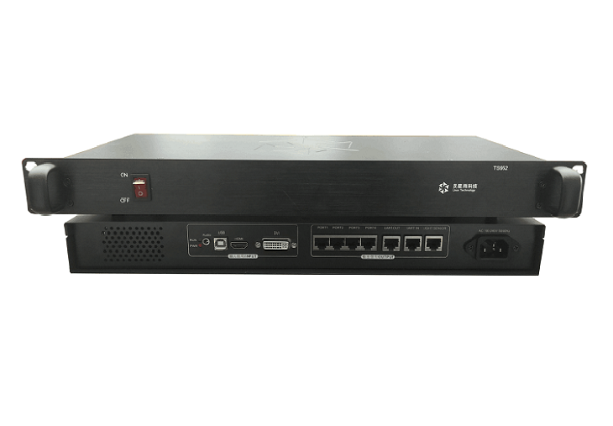
Sender Box
Descriptions
TS952 is a sender box with four network ports, and supports single, double and full color LED screen.
It also supports 4K video source input and its maximum capacity is 2.6 million pixels.
It has the following features:
1. One Audio signal input;
2. One DVI video signal input;
3. One HDMI video signal input;
4. Supports 4K video source input;
5. Supports RCG file read-back function;
6. Supports RCG file broadcasting function;
7. Supports CON file broadcasting function;
8. Supports 12bit/10bit/8bit video input;
9. Supports 16bit grey scale;
10. With four network output ports, supportscommon video source, like 2560x1024, 1920x1200, 2048x1152, etc;
11. Supported video format：RGB, YCrCB4:2:2, YCrCb4:4:4;
12. Supports cascade function;
13. Supports brightness auto-adjustment (requires light sensor).

Slide 14
6,Feature of Video Processor
NO NEED

Slide 15
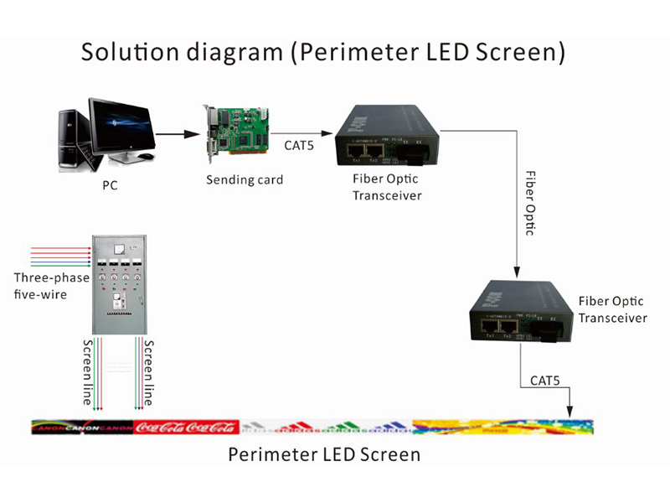

Slide 16
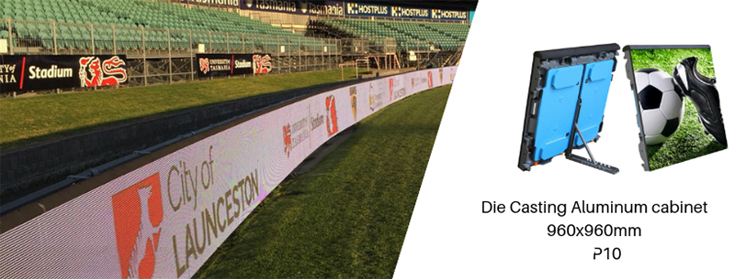
Project Cases

Slide 17
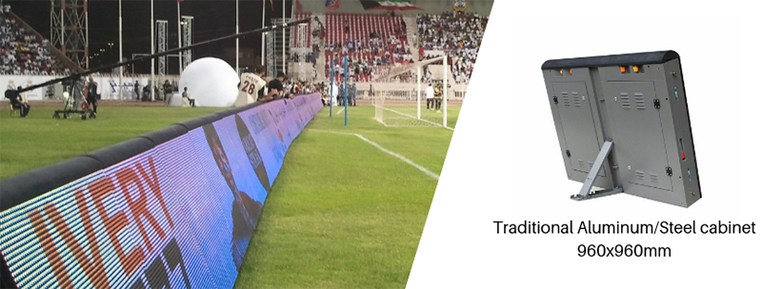

Slide 18
THANKS

